Slide 1
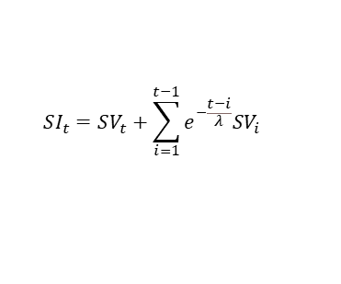
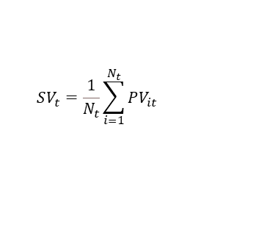
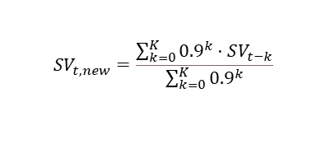
Single article with
sentiment score
Wed
Thu
Fri
Sat
Sun
Mon
Tue
Wed
Thu
Daily sentiment
intensity score
First trading day
aggregated score
Wed
Thu
Fri
Sat
Sun
Mon
Tue
Wed
Thu
Sentiment
index score
$$SV_{t}=\frac{1}{N_{t}}\sum_{i=1}^{N_{t}}{PV_{it}}$$
Wed
Thu
Fri
Mon
Tue
Wed
Thu
$$SV_{t,new}=\frac{\sum_{k=0}^{K}{{0.9}^{k}⋅SV_{t−k}}}{\sum_{k=0}^{K}{{0.9}^{k}}}$$
$$SI_{t}=SV_{t}+\sum_{i=1}^{t−1}{e^{−\frac{t−i}{λ}}SV_{i}}$$
Wed
Thu
Fri
Mon
Tue
Wed
Thu

